Slide 1
National Center of Research Summer Training Project Two 2022 Bioinformatics
Faculty of Computers and Artificial Intelligence Cairo University
Bioinformatics Department
Third Level

Slide 2
DNA Sequence Classification
Under Supervision of Dr. Enas Khalil
National Center of Research
Done by:
Sarah Hesham 20198047
Mariam Hassan 20198081

Slide 3
Over View
Text data was downloaded from UCI.com .
Text data was converted to excel sheet.
Excel sheet data was processed.
LSTM model application.
Python programming language used.

Slide 4
Objectives
Learn how to manipulate data in a .txt file and convert it to .xlsx or .csv .
What is LSTM and why is used?
Long Short-Term Memory (LSTM) networks are a type of recurrent neural network capable of learning order dependence in sequence prediction problems. This is a behavior required in complex problem domains like machine translation, speech recognition, and more. LSTMs are a complex area of deep learning.

Slide 5
About Our Dataset
Title of Database:
Primate splice-junction gene sequences (DNA) with associated imperfect domain theory.

Slide 6
About Our Dataset
Problem Description: Splice junctions are points on a DNA sequence at which `superfluous' DNA is removed during the process of protein creation in higher organisms. The problem posed in this dataset is to recognize, given a sequence of DNA, the boundaries between exons (the parts of the DNA sequence retained after splicing) and introns (the parts of the DNA sequence that are spliced out). This problem consists of two subtasks: recognizing exon/intron boundaries (referred to as EI sites), and recognizing intron/exon boundaries (IE sites). (In the biological community, IE borders are referred to a ``acceptors'' while EI borders are referred to as ``donors''.)

Slide 7
About Our Dataset
Number of Instances: 1535.
Number of Attributes: 61 -- class (one of EI, IE) -- instance name -- 60 sequential DNA nucleotide positions

Slide 8
About Our Dataset
1) One of {EI ,IE}, indicating the class.
2) The instance name.
3-62) The remaining 60 fields are the sequence, starting at position 30 and ending at position +30.
Each of these fields is almost always filled by one of {a, g, t, c}.

Slide 9
About Our Dataset
Other characters indicate ambiguity among the standard characters according to the following table:
character meaning
D A or G or T
N A or G or C or T
S C or G
R A or G
Missing Attribute Values: none
Class Distribution:
EI: 767 (49.9%) IE: 768 (50.1%)

Slide 10
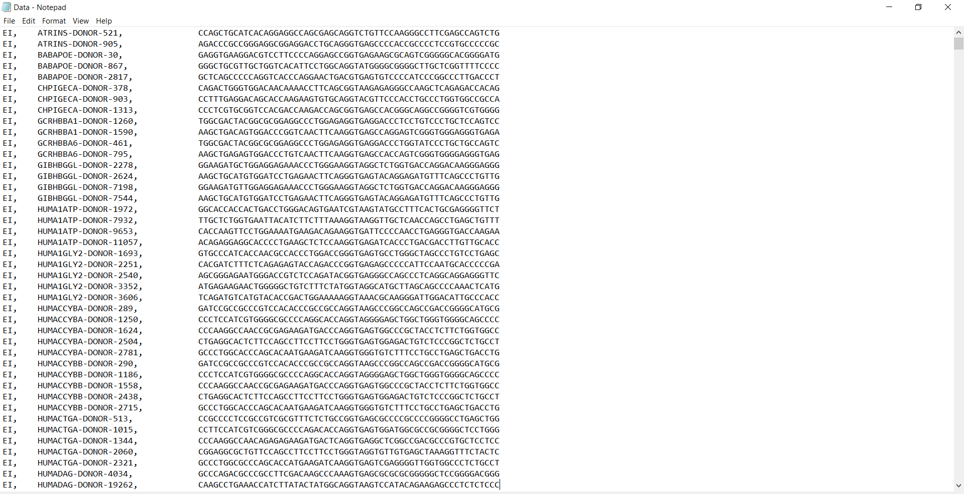
Shape of Dataset Text File

Slide 11
How Data was Processed?
Prediction Column:
Each EI was converted to a 0
Each IE was converted to a 1
Attributes:
Our data set has constant DNA sequences of length 60
So 60 attributes were created having its indices
Each A was converted to 0
Each C was converted to 1
Each G was converted to 2
Each T was converted to 3

Slide 12
What about Garbage?
It was mentioned in the data description that there is no garbage, instead there are some inaccurate values, for example:
character meaning
D A or G or T
N A or G or C or T
S C or G
R A or G
Problem solved by creating an array for each of these four letters including their expected values and a random one was chosen each time from each array at run time .

Slide 13
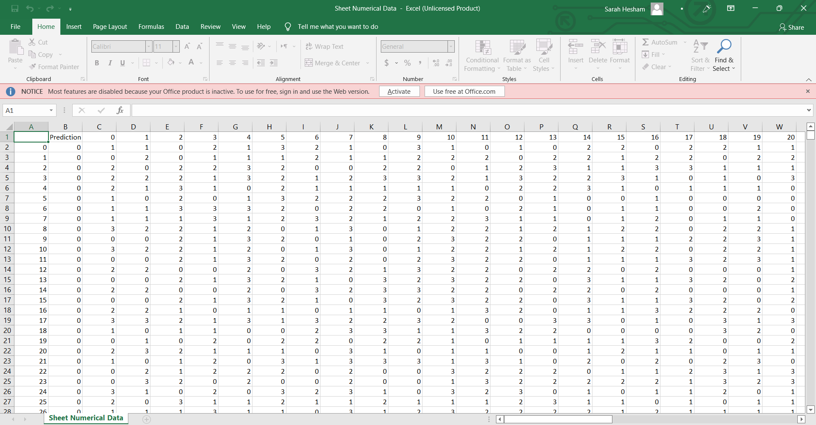
After Conversion to Excel File and Processing it

Slide 14
Applying LSTM model
Train data was 70% and test was 30%
Accuracy was 89.15%

Slide 15
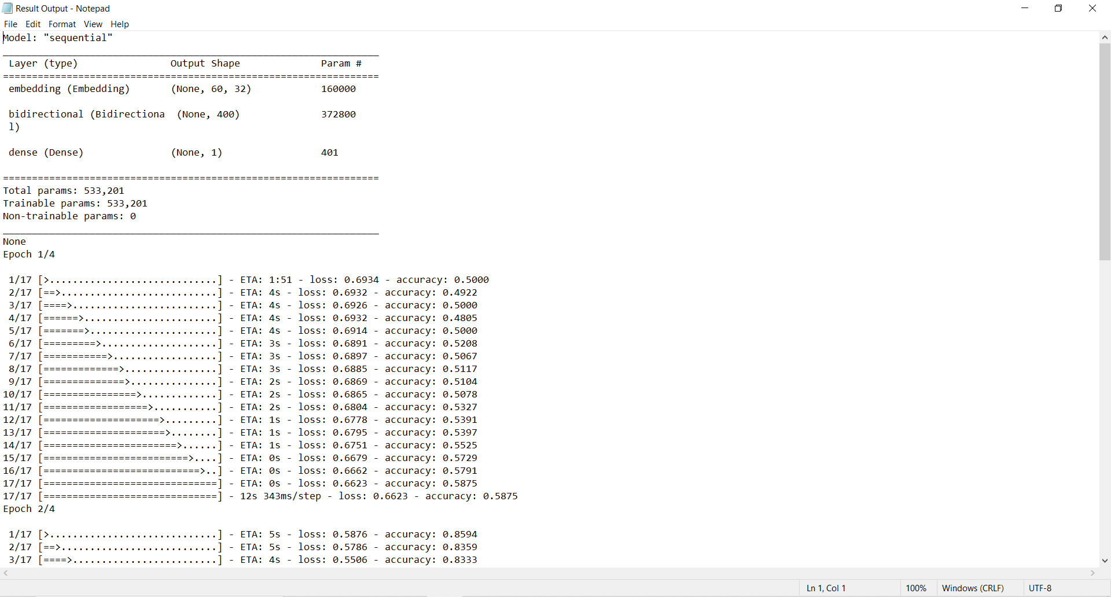
LSTM Output Text File

Slide 16
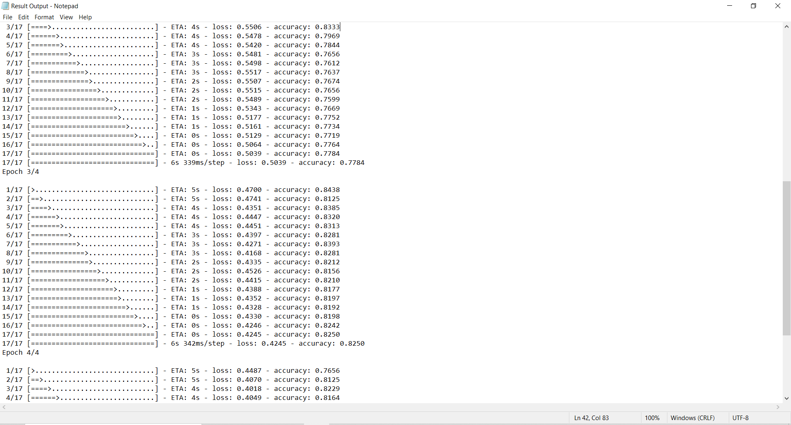
LSTM Output Text File

Slide 17
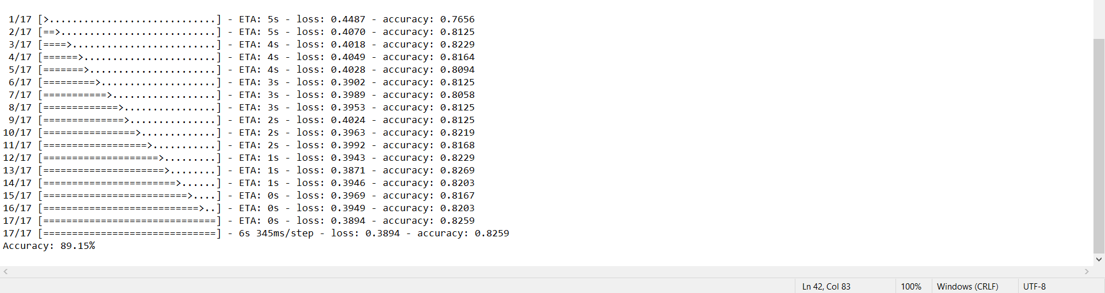
LSTM Output Text File

Slide 18
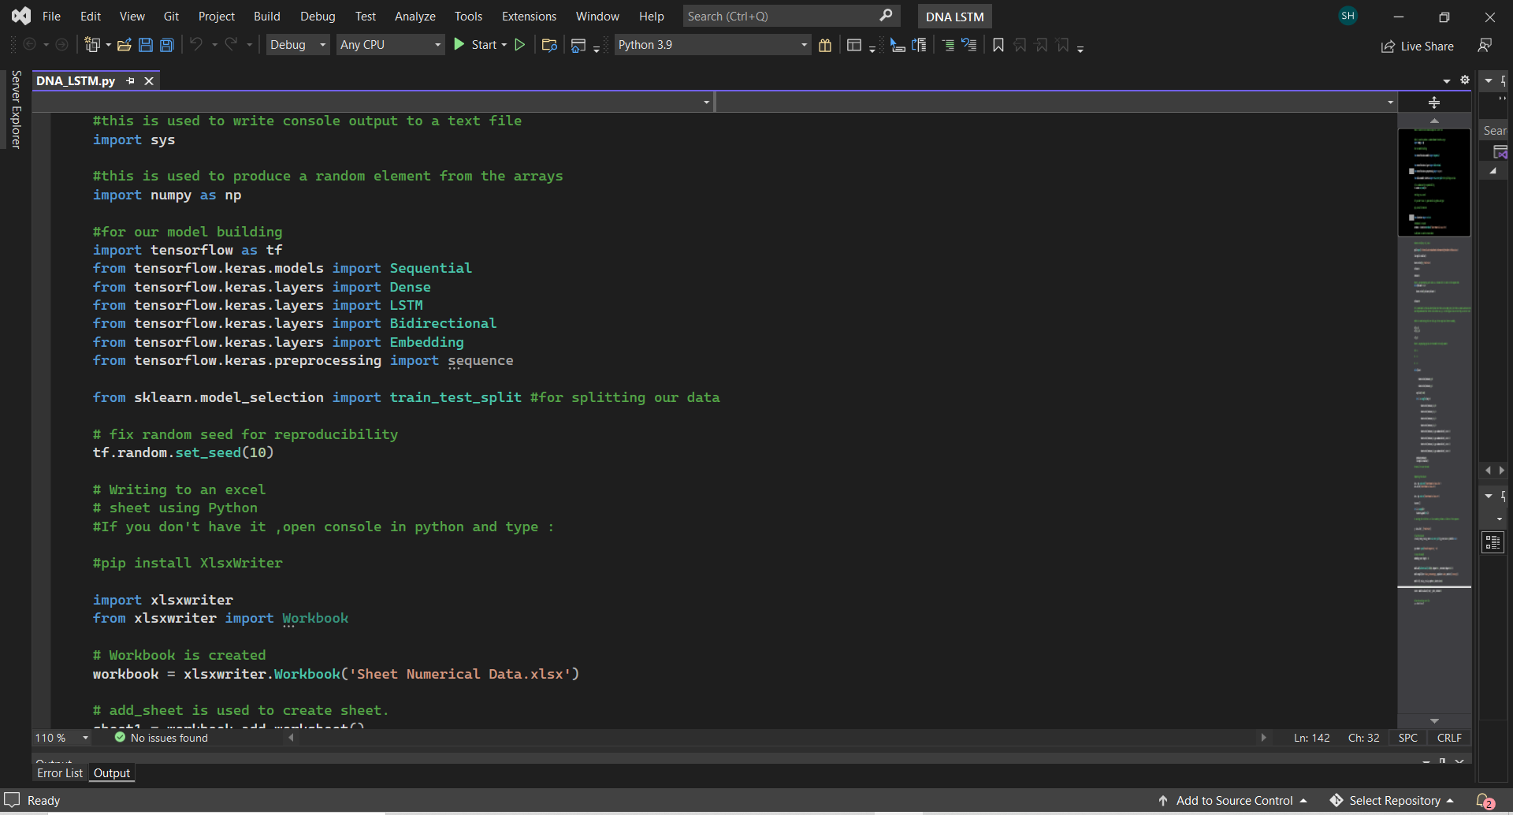
LSTM Python Code

Slide 19
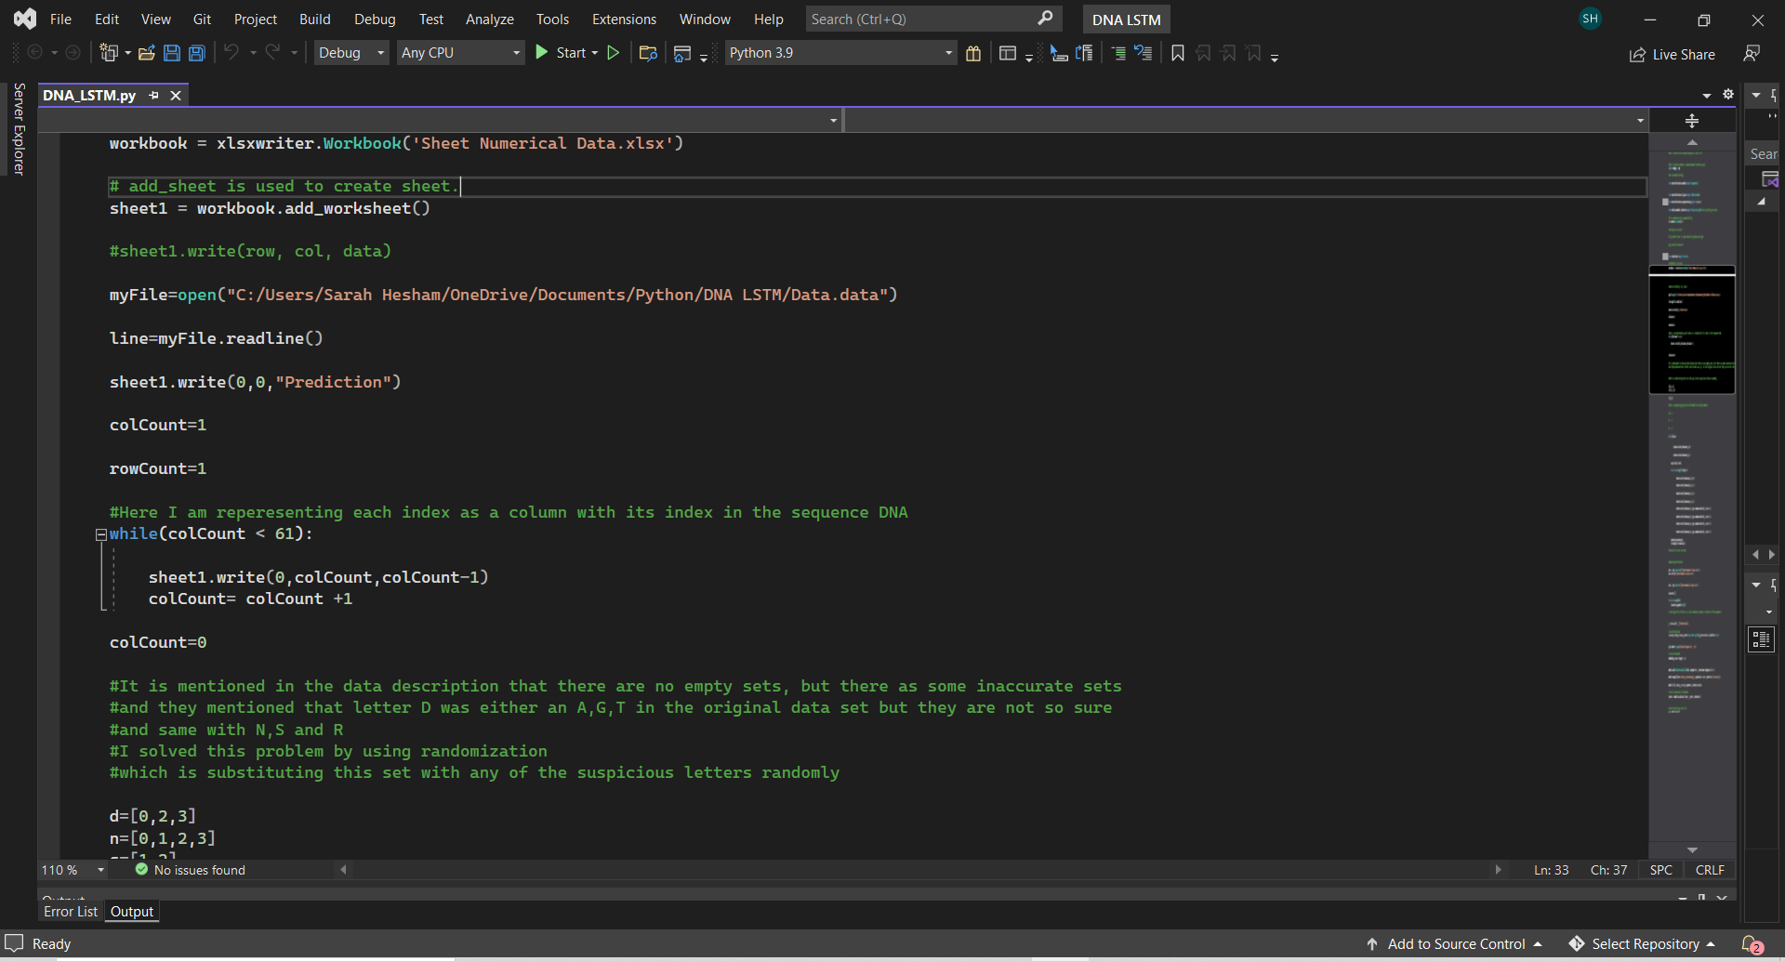
LSTM Python Code

Slide 20
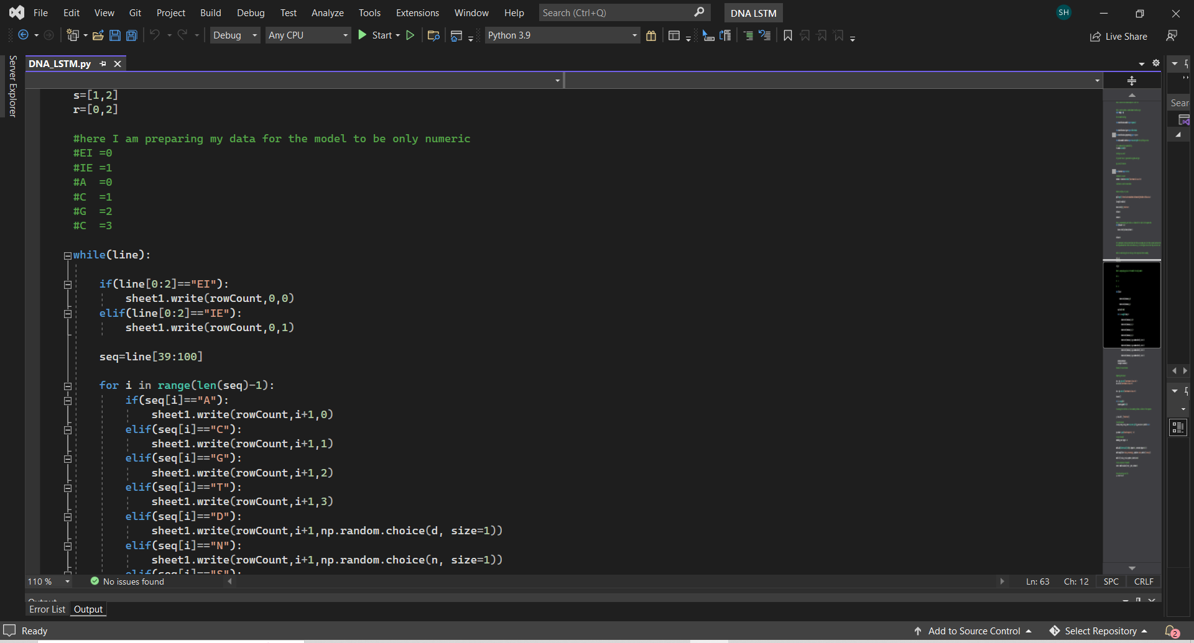
LSTM Python Code

Slide 21
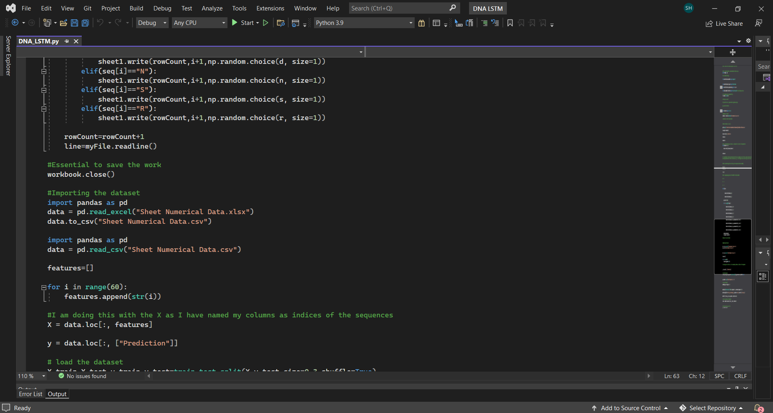
LSTM Python Code

Slide 22
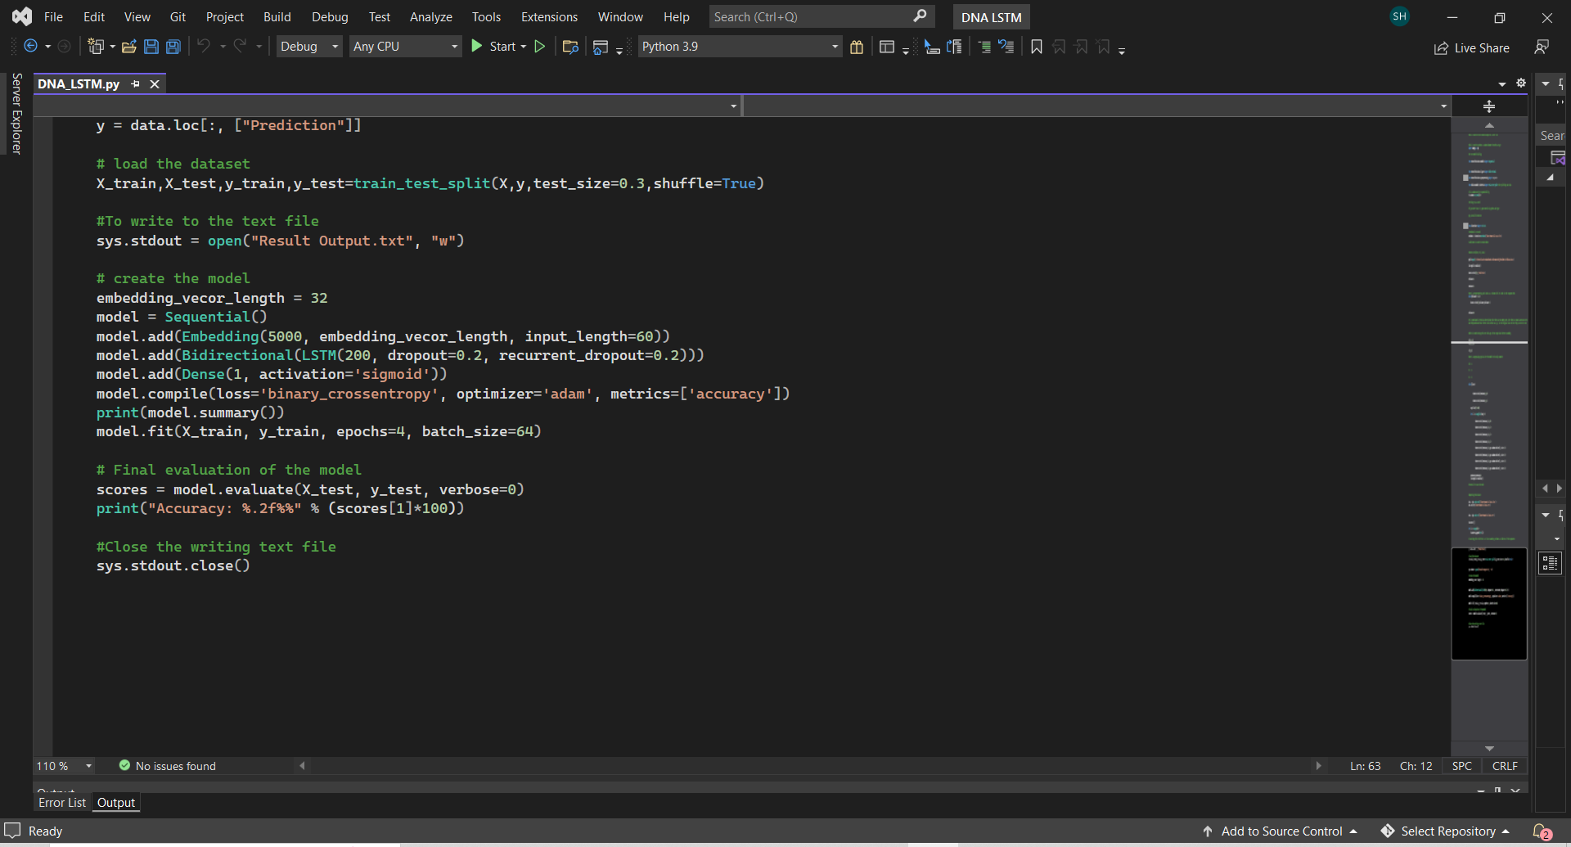
LSTM Python Code

Slide 23
Thanks !

